Slide 1


TRANSPORT APP
Here is where your route begins

Slide 2

MetroCar Funnel Analysis
Metrocar's Business model is based on a platform that connects riders with drivers through a mobile application. Metrocar acts as an intermediary between riders and drivers, providing a user-friendly platform to connect them and facilitate the ride-hailing process.

Slide 3

Project Overview
THIS PROJECT AIMS TO CONDUCT A FUNNEL ANALYSIS TO OPTIMIZE THE CUSTOMER JOURNEY AND INCREASE CONVERSION RATES BY UNDERSTANDING USER BEHAVIOR AT EACH STAGE OF THE FUNNEL, WE CAN IDENTIFY BOTTLENECKS, IMPROVE USER EXPERIENCE, AND DRIVE MORE BOOKINGS AND RIDES.

Slide 4
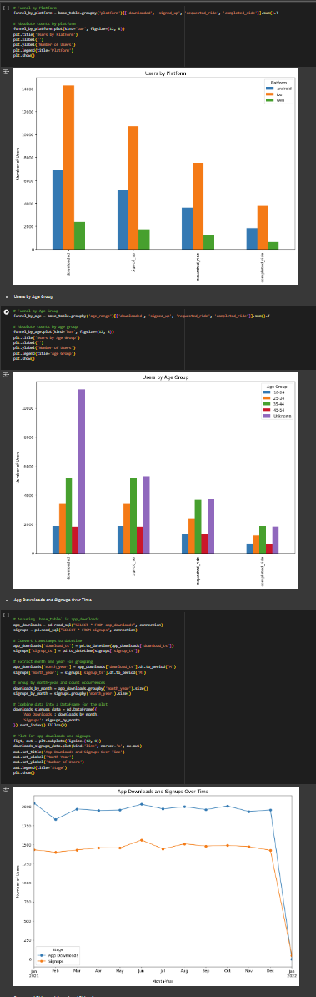
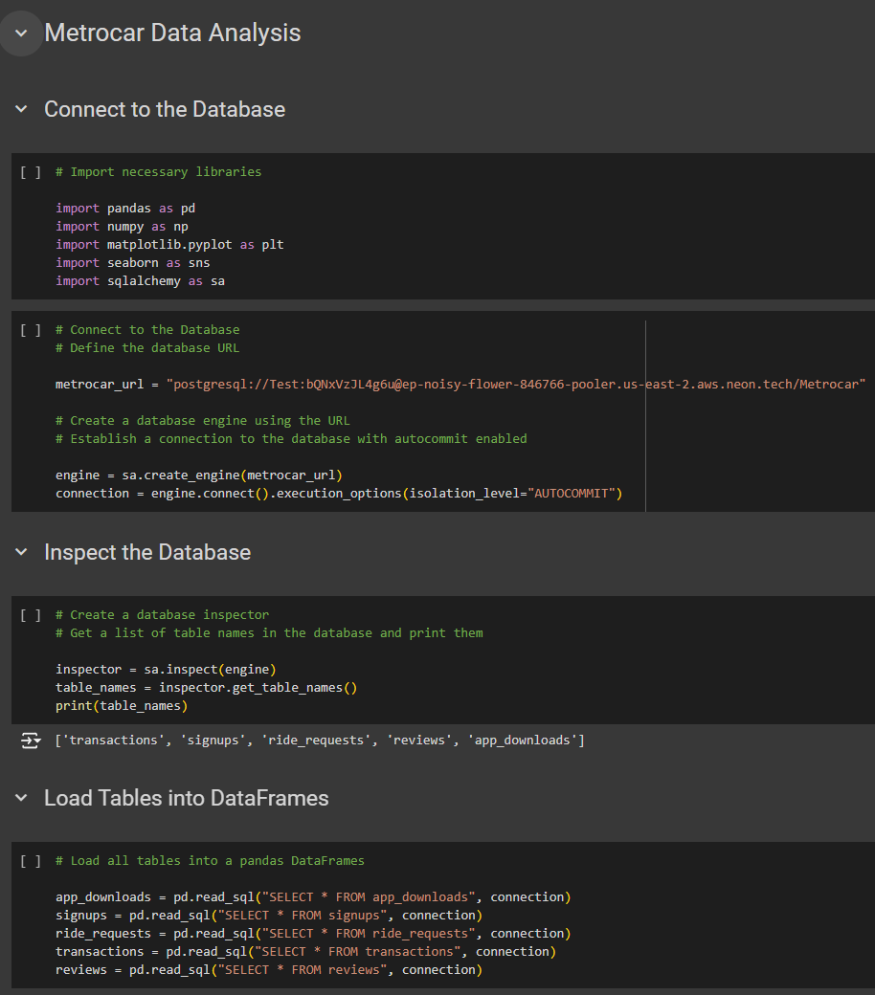
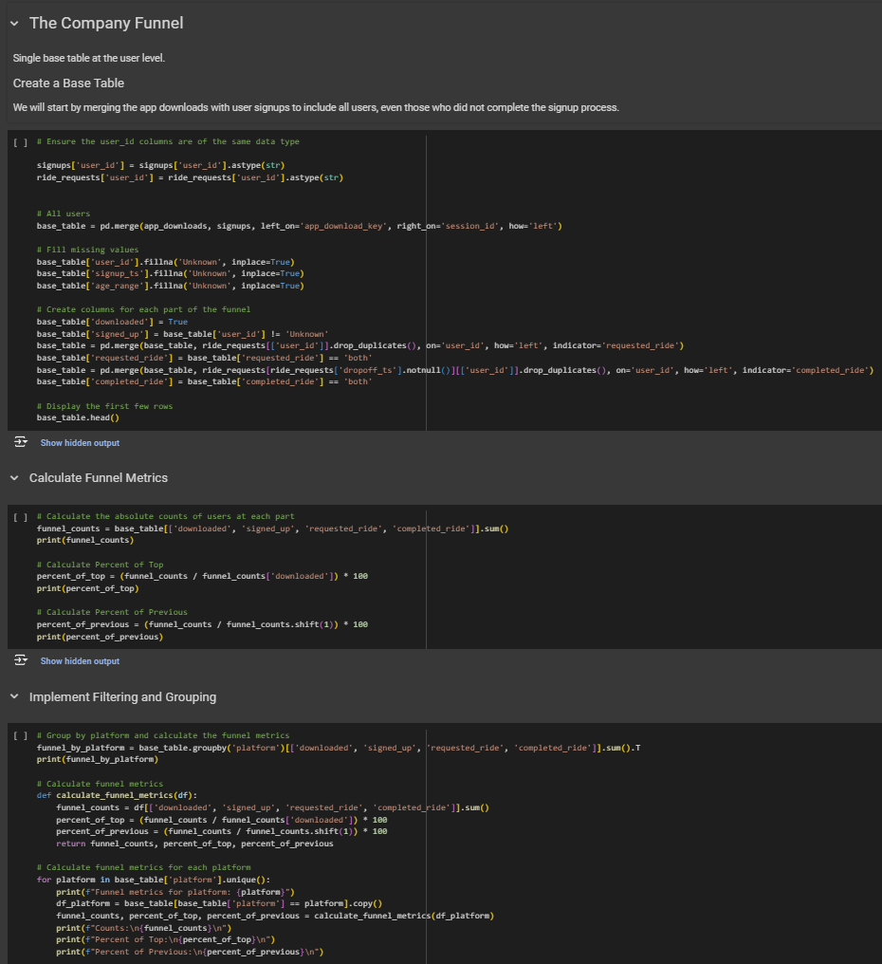
We used Google Colab and all necessary libraries for data collection, further analysis, visualization, and documentation of the work.
You can find the Colab notebook attached with the submitted files.

Slide 5
Findings
and Recommendations

Slide 6
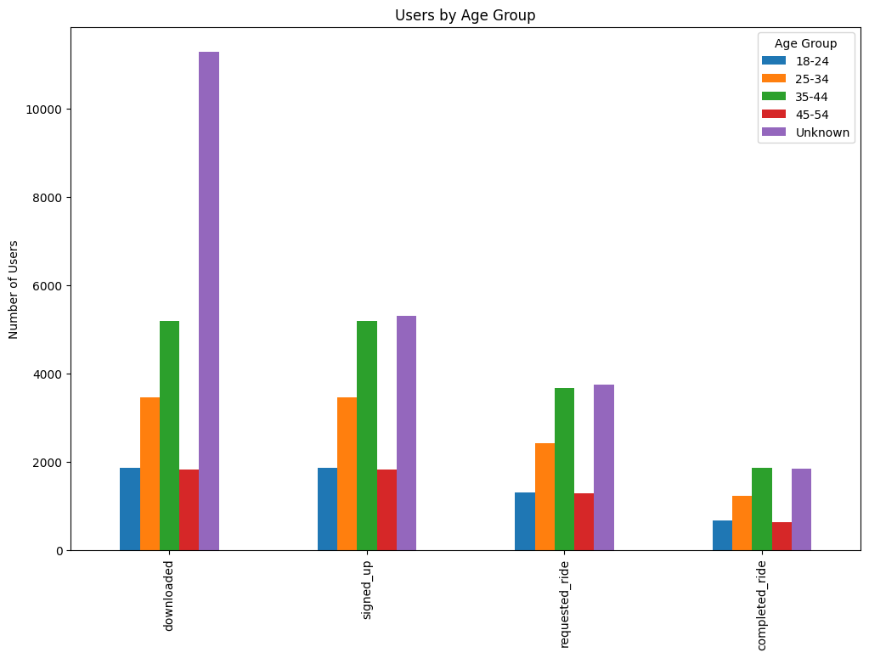
User Demographics
Findings:
The age data from signups shows that most users fall in 25-34 and 35-44 age categories.

Slide 7
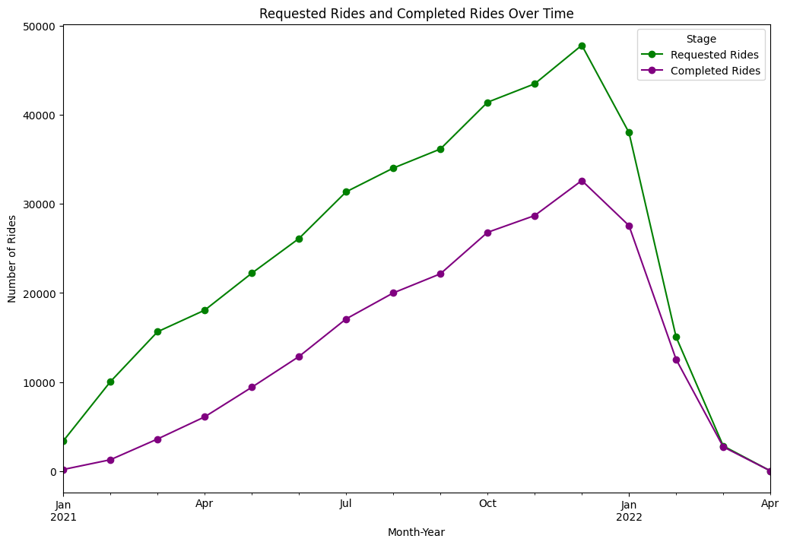
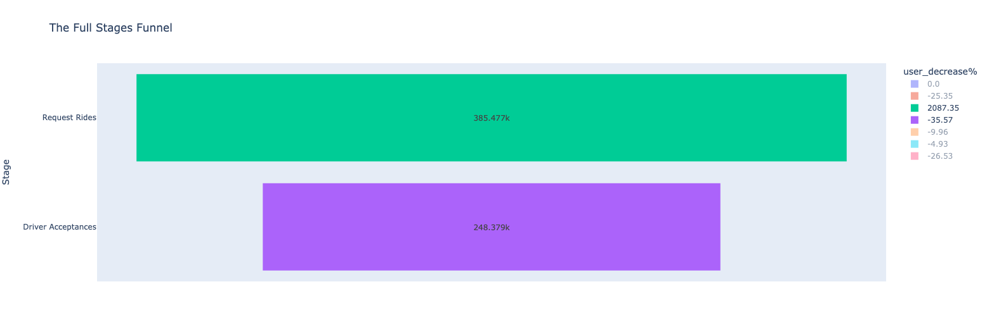
High Cancellation Rate
Findings:
Recommendations:
There is a noticeable trend of ride requests being canceled. For instance, many rides have cancellation timestamps but no acceptance or drop-off times.
Enhance User Experience
Address issues highlighted in 1-star reviews, such as driver behavior and ride reliability, to improve overall ratings.
Dynamic Pricing
Implement dynamic pricing strategies based on demand patterns identified from ride requests and transaction data to maximize revenue.

Slide 8
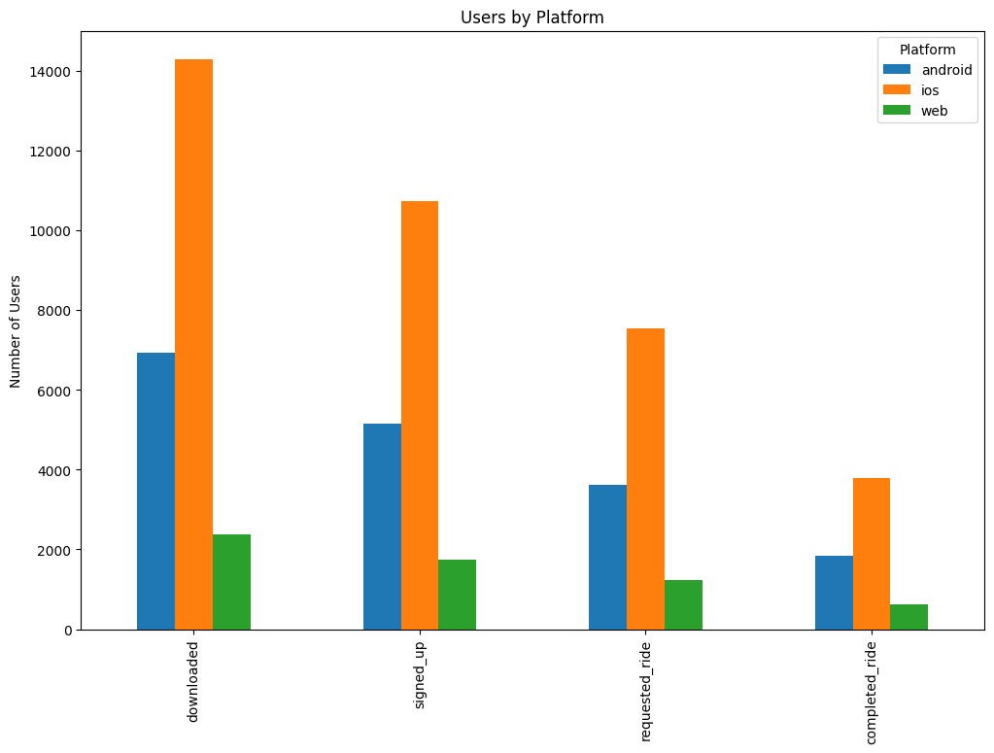
Platform Preference
Findings:
Recommendations:
The majority of app downloads occur on iOS, with fewer on Android, indicating a larger user base on iOS compared to Android or web platforms.
Expand Android Presence
Increase marketing and development efforts for the Android platform to balance the user base across different platforms.

Slide 9
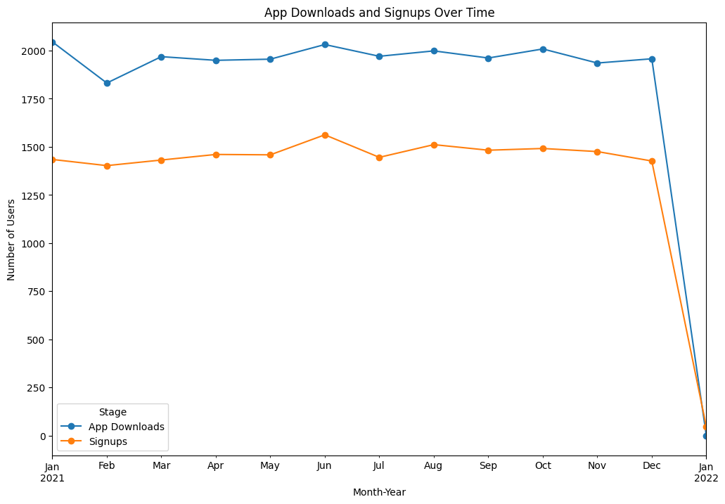
Usage Trends & Peak Signups Periods
Findings:
Usage Trends: App download data shows higher download rates at specific times of the year, likely linked to marketing efforts or seasonal demand.
Peak Signups Periods: Signup data reveals peaks at certain times of the year, suggesting periods of high user interest or effective marketing campaigns.

Slide 10
Usage Trends & Peak Signups Periods
Recommendations:
Targeted Marketing Campaigns: Focus marketing efforts during peak signups periods to further boost user acquisition.
Seasonal Promotions: Use insights from app download trends to run seasonal promotions and discounts, aligning them with periods of high user interest.

Slide 11
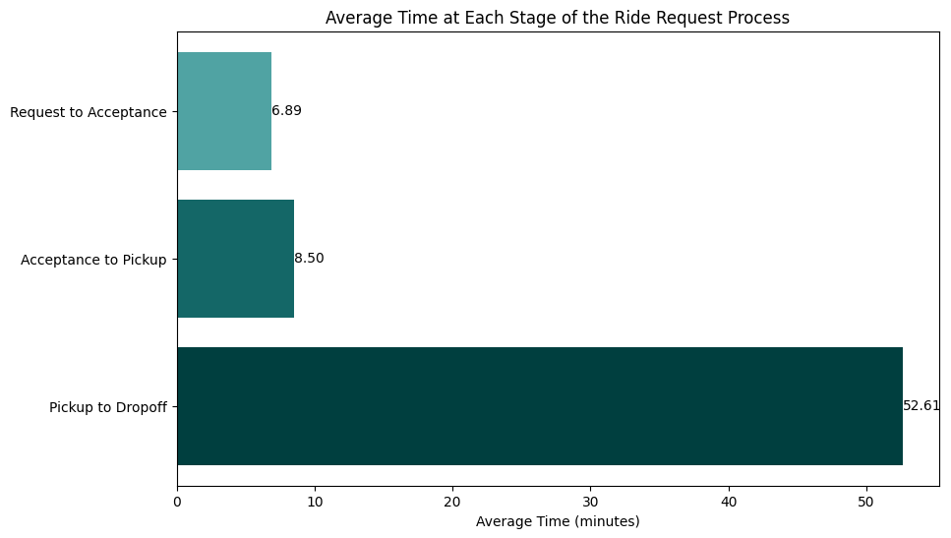
Request to Acceptance Time
Findings:
Delays between ride requests and their acceptance indicate potential inefficiencies in matching drivers with users quickly.

Slide 12
Request to Acceptance Time
Recommendations:
Improve Driver Matching Algorithm: Optimize the algorithm to reduce the time between ride requests and driver acceptance, enhancing user satisfaction.
Address Cancellation Causes: Investigate common reasons for ride cancellations and implement strategies to reduce them, such as improving driver availability or clearer communication.

Slide 13
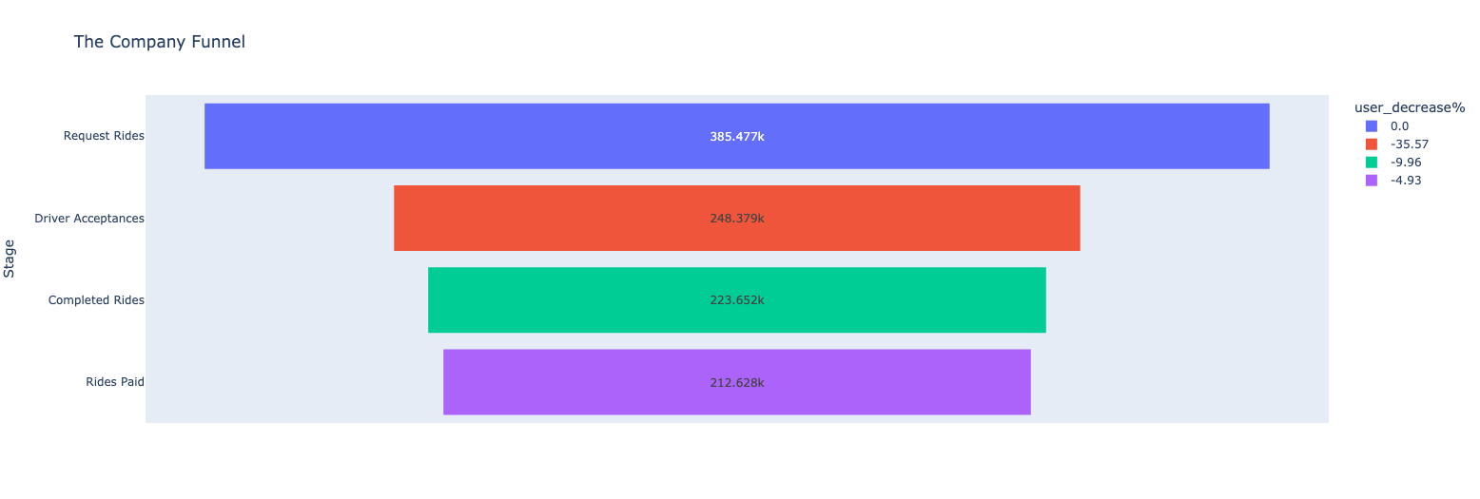
Transaction Success Rate
Findings:
The majority of transactions are approved, indicating a reliable payment processing system.

Slide 14
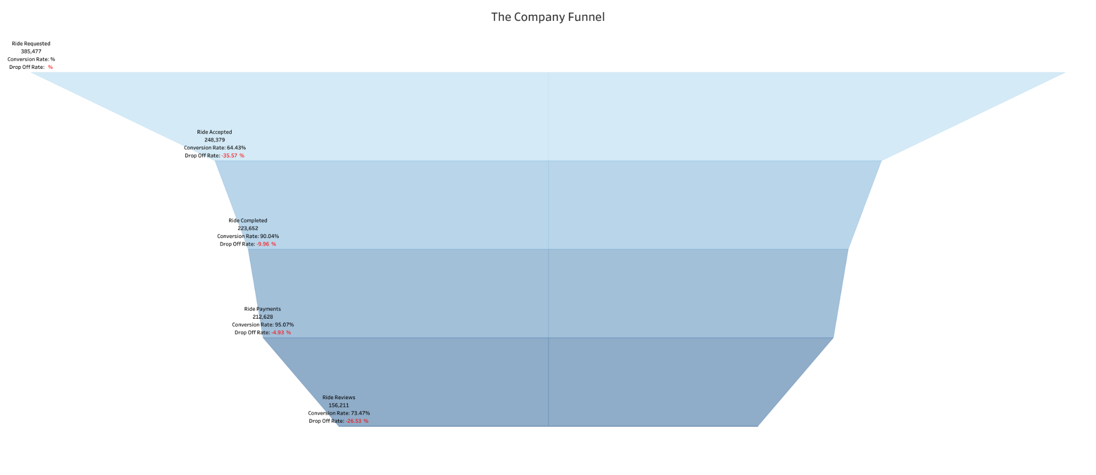
The Company Funnel

Slide 15
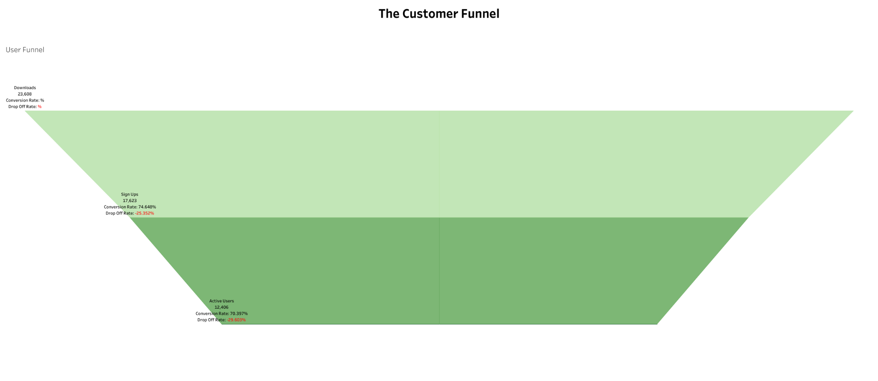
The Customer Funnel

Slide 16
Presented By
Sarmad Khader
Ramya Logaiyan
Md Arman Kaishar

Slide 17

Thank You

